Slide 1


Project Title: CI/CD - DevOps Duration: 01/09/2025 – 30/09/2025 Organization: Sunbeam Institute Of Information Technology
Submitted by: Neha Sanjay Kumbharde

Slide 2

Agenda / Roadmap
Day 1 (01/09/2025): Docker install, build Docker image, launch two containers (app + DB)
Day 2 (09/09/2025): Create two VMs, set up Kubernetes cluster
Day 3 (12/09/2025): Deploy application in Kubernetes (Deployment + Service)
Day 4 (15/09/2025): Add persistence (PV/PVC), set up CI/CD (GitHub Actions + ArgoCD + Helm)
Day 5 (22/09/2025): Monitoring with Prometheus + Grafana + Alerts, integrate with pipeline

Slide 3

Day 1 — Docker Setup (Goals & Architecture) Goals: Install Docker on Ubuntu/Debian Create a Docker image for the “todo app” Launch two containers: • a database container (e.g. PostgreSQL or MySQL) • the todo application container

Slide 4
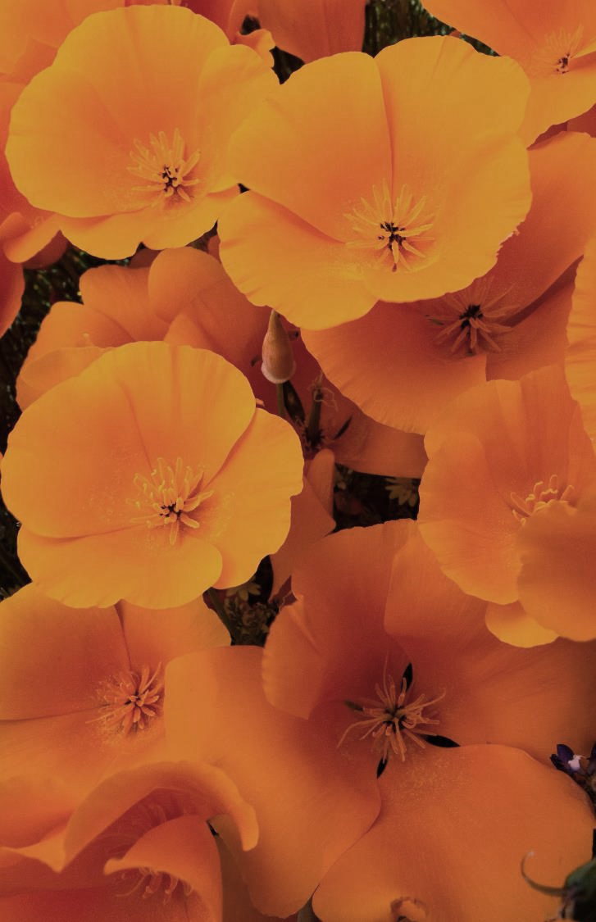
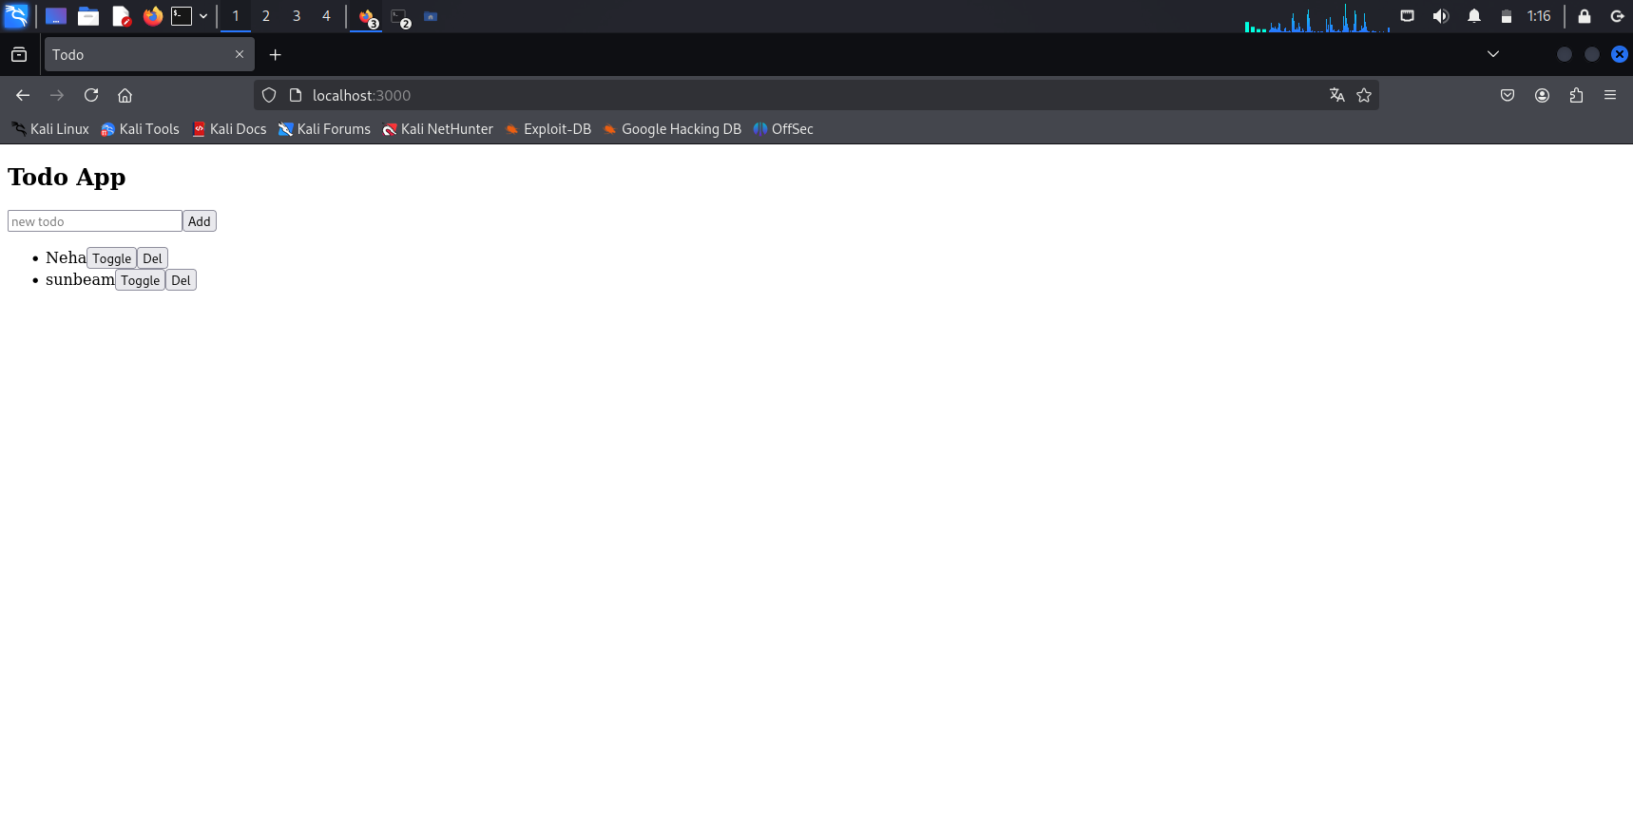

Slide 5
Day 2 — Kubernetes Cluster Setup
Steps:
Provision two VMs (could be on local VM hypervisor or cloud)
Install kubeadm, kubelet, kubectl on both
Initialize control-plane on VM1: kubeadm init ...
Join VM2 as worker: kubeadm join ...
Install a CNI (e.g. Calico, Flannel) for pod networking
Confirm nodes are Ready: kubectl get nodes

Slide 6

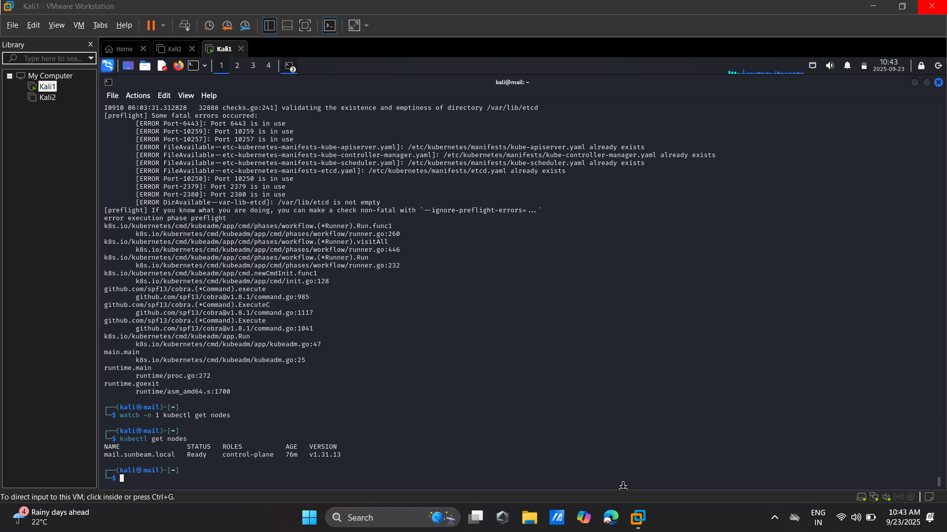
Selecting visual aids
Enhancing your presentation

Slide 7
Day 3 — Kubernetes Deployment & Service
Ojectives:
eploy the Todo App and Database to Kubernetes.
Create Deployment and Service YAML files.
Tools Used:
Kubernetes YAML files (Deployment, Service)
kubectl
Tasks and Implementation:
Created Deployments:
todoapp-deployment.yaml:
db-deployment.yaml: For PostgreSQL or SQLite depending on your app.
Applied Configs:
kubectl apply -f todoapp-deployment.yaml
Kubectl apply -f db-deployment.yaml
Kubectl apply -f todoapp-service.yam

Slide 8
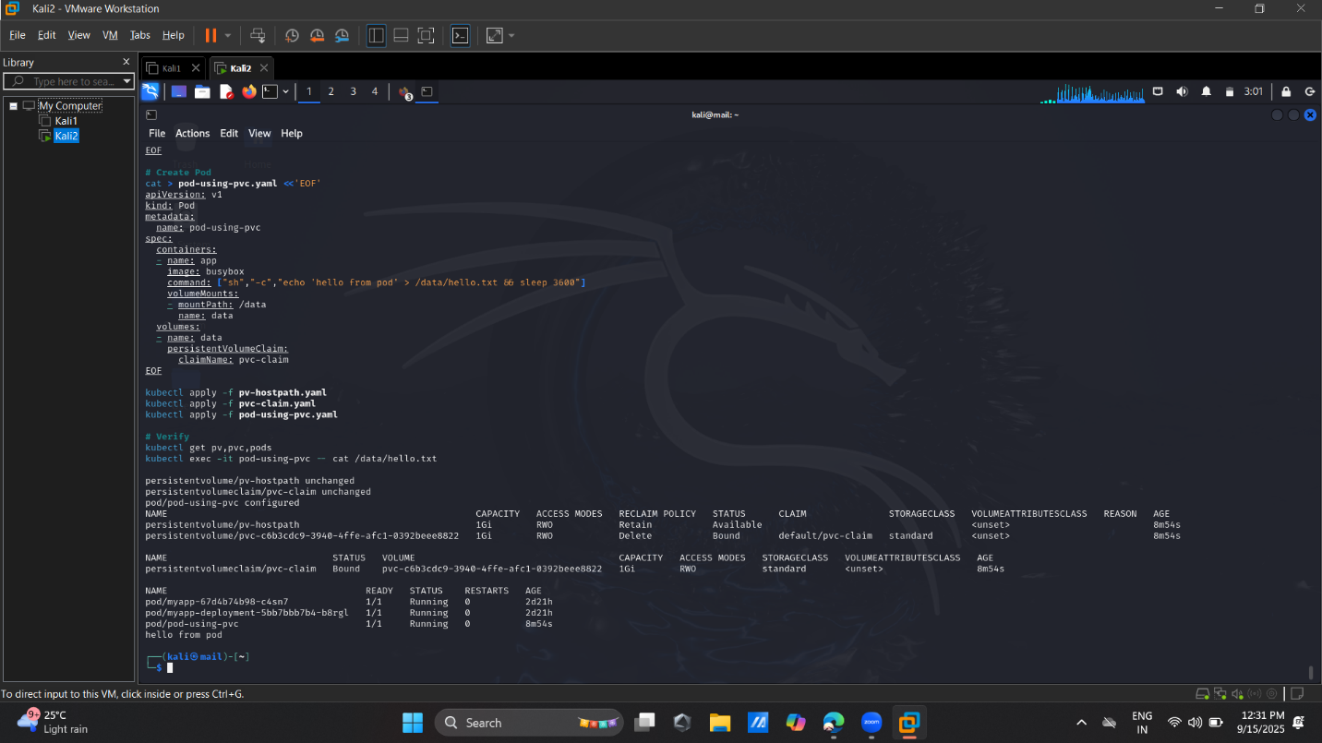
Navigating Q&A sessions

Slide 9

Day 4 — Persistent Volumes & PVCs
Concepts:
PV (Persistent Volume): Cluster resource — storage abstraction.
PVC (Persistent Volume Claim): A request by a pod for storage.
StorageClass: defines dynamic provisioning.

Slide 10
CI/CD: GitHub Actions + ArgoCD + Helm
CI (GitHub Actions):
On push to main branch, build Docker image, run tests, push image to registry (Docker Hub, GitHub Container Registry)
Sample workflow steps: checkout, setup-python, build, push
CD (ArgoCD):
Point ArgoCD to a Git repo that contains your Kubernetes manifests / Helm chart
ArgoCD automatically syncs changes to the cluster
Helm Charts:
Directory structure: Chart.yaml, values.yaml, templates/
Templatize Deployment, Service, PVC, etc.
Use helm install / helm upgrade

Slide 11
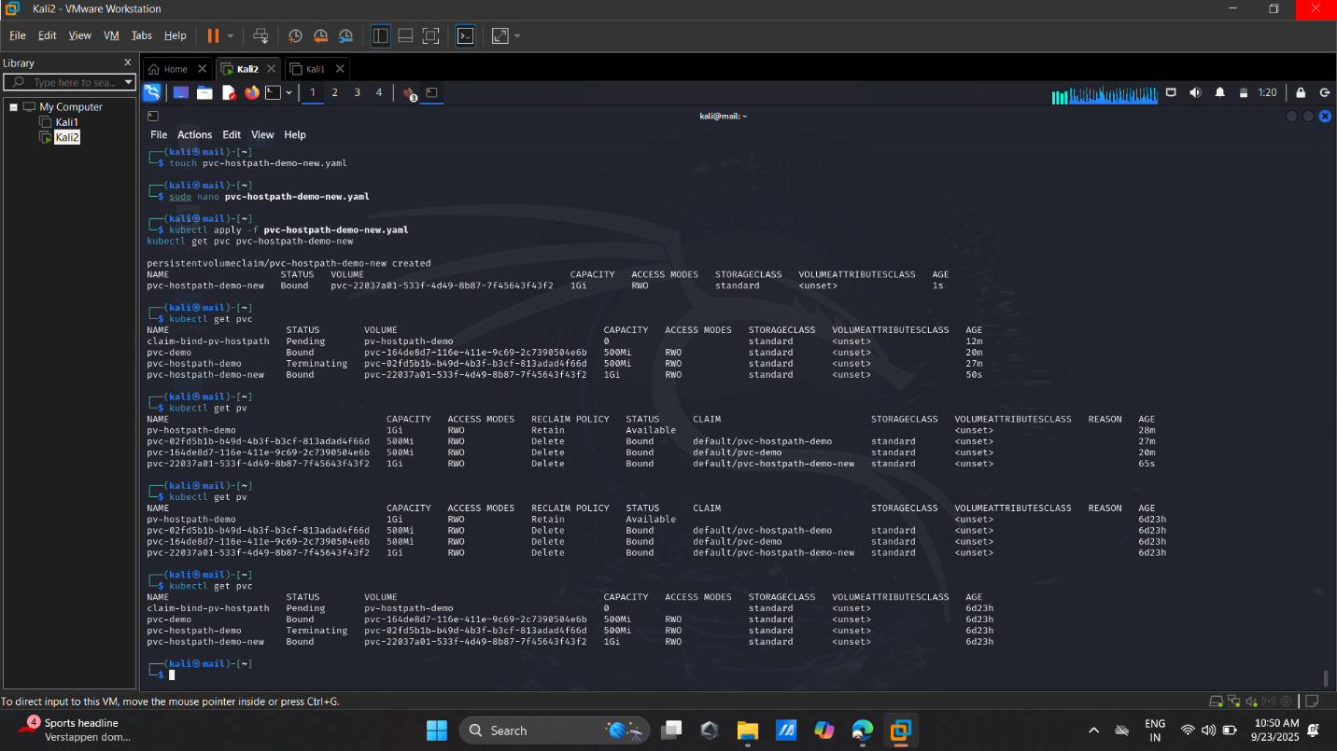

Slide 12
Day 5 — Monitoring with Prometheus
Architecture & Components:
Prometheus server (scrapes metrics)
Exporters: node-exporter (infrastructure), cAdvisor (container / K8s metrics), custom Flask metrics endpoint
Prometheus configuration (scrape_configs)
Metrics to collect:
CPU / memory / disk usage of nodes / pods
HTTP request rates, latency, error rates from Flask
DB metrics if possible (connections, query time)

Slide 13
Grafana Dashboards & Alerts
Grafana:
Dashboards: CPU / memory overview, per-pod metrics, request latency, DB metrics
Panels: line charts, gauges, bar charts

Slide 14
Thank you
Neha Sanjay Kumbharde
nehakumbharde1999@gmail.com

